Slide 1



Transfer Learning & Batch Normalization in Neural Networks
An Empirical Study on Image Classification Performance, Backbone Fine-Tuning Strategies, and Deep Network Convergence Stability
Tanush Shoor
tanush.shoor09@gmail.com
Neural Networks & Computer Vision
Prof. Priyansh Saxena

Slide 2






Executive Summary & Key Research Findings
Task 1: Transfer Learning
Task 2: Batch Normalization
Practical Implications
Objective: Overcome data scarcity constraints in image classification by re-using feature representations learned on massive benchmarks.
Objective: Mitigate Internal Covariate Shift in deep neural networks (>6 hidden layers) on the Fashion-MNIST dataset.
Engineering Rule: Never train deep CNNs from scratch when less than 10k labeled images are available. Always leverage Transfer Learning backbones.
Key Finding: Batch Normalization accelerated gradient flow, reducing final loss from 0.1733 down to 0.1199 while smoothing loss curves and stabilizing convergence.
Key Finding: Fine-tuning a pre-trained ResNet18 yielded an extraordinary 99.5% accuracy on a small 1,000-image dataset compared to 61.5% from a CNN trained from scratch.
Optimization Rule: Insert BatchNorm layers between linear projections and activations to stabilize deeper topologies and prevent vanishing gradients.

Slide 3


Task 1: The Challenge of Small Datasets
The Small Dataset Dilemma
The Transfer Learning Solution
Deep Convolutional Neural Networks require millions of parameters to learn hierarchical visual features (edges, textures, object parts). When trained on small datasets (e.g., ~1,000 images):
Transfer Learning reuses feature maps learned by a primary model trained on a massive source domain (e.g., ImageNet with 1.2M images across 1,000 classes) and transfers them to a target task:
Frozen Backbone (Feature Extractor): Freezes low-level feature representations and trains only a new classification head.
High Overfitting Risk: Models memorize individual sample noise rather than generalizable visual features.
Fine-Tuned Adaptation: Unfreezes upper convolutional blocks to fine-tune representations specifically for target domain distributions.
Poor Feature Hierarchy: Lower layers fail to develop robust Gabor-like edge detectors due to insufficient gradient updates.
Suboptimal Accuracy: Random weight initializations struggle to find favorable minima in high-dimensional loss landscapes.
Drastic Data Efficiency: Achieves benchmark performance with 10x-100x fewer labeled training instances.

Slide 4



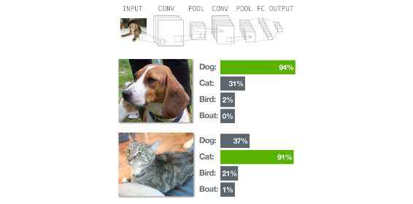
Dataset Specification: Cats vs Dogs Mini
Dataset Profile
The Cats vs Dogs Mini benchmark dataset presents realistic computer vision challenges with varied lighting, backgrounds, occlusions, and camera angles.
Attribute | Specification Details
Total Sample Volume | 1,000 labeled RGB images
Class Distribution | 500 Cats (50%) | 500 Dogs (50%) — Perfectly Balanced
Train / Val Partition | 80% Training (800 imgs) | 20% Validation (200 imgs)
Input Resolution | Resized & Cropped to 224 × 224 pixels
Normalization Pipeline | ImageNet Mean [0.485, 0.456, 0.406], Std [0.229, 0.224, 0.225]
Preprocessing Necessity: standardizing image spatial dimensions to 224x224 and normalizing channel intensity distributions is essential for compatibility with pre-trained ResNet tensor formats.

Slide 5


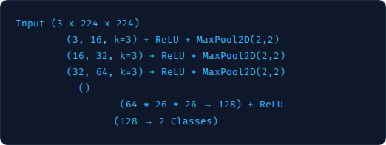


Model 1: Custom CNN Trained From Scratch
Architecture Pipeline
Loss Progression & Metrics
Epoch Number | Training Cross-Entropy Loss
Epoch 1 | 0.7968
Epoch 2 | 0.6872
Epoch 3 | 0.6451
Epoch 4 | 0.6260
Epoch 5 | 0.5838
→
Conv2D
→
Conv2D
→
Conv2D
→
Flatten
→
FullyConnected
→
Linear Output
Key Characteristics
Random parameter initialization, standard cross-entropy loss optimization using Adam optimizer. Trained across 5 epochs on 800 training samples.
61.5%
Validation Accuracy Achieved

Slide 6




Model 2: Frozen ResNet18 Feature Extractor
Frozen Backbone Strategy
Loss Trajectory & Metrics
ResNet18 pre-trained on 1.2 Million ImageNet instances is leveraged as a fixed feature extractor:
Epoch | Training Loss | Performance Delta
Epoch 1 | 0.4628 | Initial drop vs Scratch
Epoch 2 | 0.2318 | Fast convergence
Epoch 3 | 0.1501 | Steady refinement
Epoch 4 | 0.1454 | Stabilizing
Epoch 5 | 0.1238 | Final training loss
Frozen Layers: All convolutional blocks (`conv1` through `layer4`) are frozen (`requires_grad = False`).
Preserved Knowledge: Low, mid, and high-level visual features (edges, textures, shapes) remain intact.
Trainable Head: The final FC layer (512 inputs) is replaced with a 2-class linear output classifier (`requires_grad = True`).
Computational Efficiency: Training requires computing gradients for only 1,026 parameters in the final layer instead of 11.1 Million parameters, enabling rapid execution.
97.0%
Validation Accuracy (+35.5% vs Scratch)

Slide 7




Model 3: Fine-Tuned ResNet18 Adaptation
Selective Unfreezing Strategy
Training Loss Trajectory
Rather than freezing all backbone parameters, upper layers are unfrozen to allow feature representations to adapt specifically to animal features:
Epoch | Training Loss | Convergence Status
Epoch 1 | 0.1743 | Rapid initial drop
Epoch 2 | 0.0346 | Near-zero error
Epoch 3 | 0.0087 | High precision refinement
Epoch 4 | 0.0062 | Asymptotic convergence
Epoch 5 | 0.0038 | Optimal loss minimum
Base Weights: Initialized with ImageNet pre-trained parameters.
Unfrozen Block: The final convolutional block (`layer4`) is set to `requires_grad = True`.
Joint Optimization: Adapts high-level abstract representation filters specifically to distinguish cat/dog anatomy.
Optimal Performance Paradigm
Fine-tuning allows small gradient adjustments to flow back into high-level conv layers, customizing semantic spatial filters without destroying low-level edge features.
99.5%
Validation Accuracy (Near Perfect)

Slide 8


Task 1: Comprehensive Model Comparison
Model Strategy | Trainable Params | Epoch 1 Loss | Epoch 5 Loss | Val Accuracy | Performance Tier
CNN From Scratch | ~150,000 | 0.7968 | 0.5838 | 61.5% | Baseline (Underfitting)
Frozen ResNet18 | 1,026 (FC layer) | 0.4628 | 0.1238 | 97.0% | High Efficiency (+35.5%)
Fine-Tuned ResNet18 | ~8.5 Million (Layer 4 + FC) | 0.1743 | 0.0038 | 99.5% | State-of-the-Art (+38.0%)
Loss Convergence Rate
Key Validation Takeaway
Fine-Tuned ResNet18 achieved an epoch 5 training loss of 0.0038, which is 153x lower than the CNN trained from scratch (0.5838) and 32x lower than Frozen ResNet18 (0.1238).
Re-using generic lower-level ImageNet filters while adapting high-level semantic features enables deep neural networks to achieve near-perfect generalizability even with only 800 training images.

Slide 9






Task 1: Deep Analytical Takeaways
1. Visual Hierarchy Transfer
2. Overfitting Immunity
3. Unfreezing Synergy
Early layers in CNNs detect edges, lines, and textures regardless of domain. Reusing ImageNet features circumvents the need to learn basic visual primitives from small datasets.
Training a deep model from scratch on 800 images causes severe overfitting. Pre-trained weights act as an extremely strong regularizer, guiding optimization toward generalized minima.
Frozen ResNet18 reaches 97% accuracy, but unfreezing `layer4` bridges the remaining gap to 99.5% by tailoring high-level dog/cat facial structures and coat textures.
Practical Rule of Thumb: For domain-specific tasks with limited training samples, start with a frozen pre-trained backbone. If additional accuracy is required, selectively unfreeze upper convolutional layers with a reduced learning rate.

Slide 10
Task 2: Internal Covariate Shift & Batch Norm
Internal Covariate Shift
The Batch Normalization Fix
As parameters in preceding layers update during backpropagation, the input distribution to deeper layers continually shifts. This creates major training challenges:
Introduced by Ioffe & Szegedy (2015), Batch Normalization normalizes the layer inputs across each mini-batch, fixing their mean and variance:
Slower Convergence: Layers must constantly re-adapt to shifting input distributions, requiring tiny learning rates.
Stabilized Distribution: Maintains zero mean and unit variance for intermediate activations across mini-batches.
Vanishing/Exploding Gradients: Unbounded layer activations push non-linear activations (like Sigmoid/Tanh) into saturated regimes.
Accelerated Optimization: Allows significantly higher learning rates without risk of gradient explosion.
Weight Initialization Sensitivity: Deep networks (>5 layers) become hyper-sensitive to initial weight scales.
Regularization Effect: Mini-batch noise acts as a mild regularizer, reducing dependence on Dropout.

Slide 11

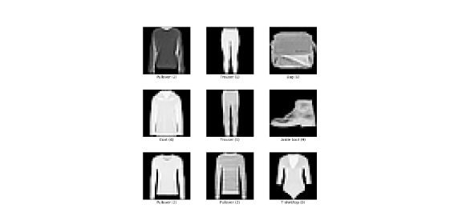

Dataset Specification: Fashion-MNIST
Benchmark Dataset Profile
Fashion-MNIST serves as a direct drop-in replacement for classic MNIST, offering higher visual complexity across 10 distinct apparel categories.
Dataset Metric | Value & Properties
Total Dataset Volume | 70,000 grayscale images
Train / Test Split | 60,000 Training | 10,000 Testing images
Spatial Resolution | 28 × 28 pixels (784 features flattened)
Number of Classes | 10 Apparel Categories (Balanced)
10 Apparel Categories
T-shirt/top, Trouser, Pullover, Dress, Coat, Sandal, Shirt, Sneaker, Bag, Ankle boot.

Slide 12

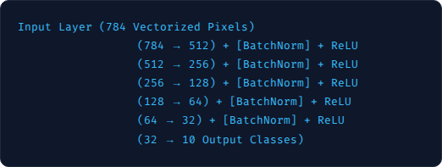
Deep Network Architecture Topology
Deep MLP Topology (>6 Trainable Layers)
Controlled Experimental Setup
To rigorously measure the isolated impact of Batch Normalization, two identical architectures were constructed:
→
Linear Layer 1
Model A (No BatchNorm): Standard Linear layers followed directly by ReLU non-linear activation functions.
→
Linear Layer 2
→
Linear Layer 3
→
Linear Layer 4
Model B (With BatchNorm): `nn.BatchNorm1d` inserted after every Linear projection and before ReLU activation.
→
Linear Layer 5
→
Linear Layer 6
Consistency: Both models share identical weight initializations, Adam optimizer parameters, batch sizes, and learning rates.

Slide 13









Mathematical Formulation of Batch Norm
For a mini-batch containing values of activation , Batch Normalization executes four sequential operations:
1. Mini-Batch Mean Calculation
2. Mini-Batch Variance Calculation
Computes the mean activation across all samples in the current mini-batch.
Measures activation dispersion across the mini-batch.
3. Activation Normalization
4. Scale and Shift Transformation
Applies learnable parameters and to restore representation capacity if needed.
Standardizes distribution to zero mean and unit variance ( prevents division by zero).

Slide 14


Task 2: Experimental Results & Loss Profiles
Model Configuration | Epoch 1 Loss | Epoch 10 Loss | 10-Epoch Accuracy | Epoch 20 Loss | 20-Epoch Accuracy
Model A: No BatchNorm | 0.6164 | 0.2402 | 88.75% | 0.1733 | 88.75%
Model B: With BatchNorm | 0.5523 | 0.2091 | 89.57% | 0.1199 | 89.57%
Loss Reduction Performance
Convergence Velocity
At 20 epochs, Batch Normalization reduced training loss to 0.1199 compared to 0.1733 without BatchNorm—representing a 30.8% reduction in training error.
Model B with BatchNorm achieved an epoch 1 loss of 0.5523, reaching a training loss level in 5 epochs that Model A required nearly 8 epochs to reach.

Slide 15







Optimization & Convergence Stability
1. Loss Landscape Smoothing
2. Gradient Flow Preservation
3. Optimization Efficiency
BatchNorm smooths the loss surface gradients (Santurkar et al., 2018), making gradient steps more predictable and preventing wild directional oscillations.
By keeping intermediate layer activations bounded, gradients do not explode or vanish as backpropagation traverses all 6 hidden layers.
While final classification accuracy showed a modest increase (+0.82%), the primary value of BatchNorm lies in its dramatic optimization efficiency and loss reduction.
Key Takeaway: Batch Normalization acts primarily as an optimization stabilizer rather than a raw accuracy booster. It enables deeper architectures to be trained robustly without requiring delicate hyperparameter tuning.

Slide 16
Comparative Synthesis of Key Techniques
Dimension | Task 1: Transfer Learning | Task 2: Batch Normalization
Primary Challenge Addressed | Data scarcity on small datasets (~1k samples) | Internal Covariate Shift & unstable deep training
Core Mechanism | Reusing pre-trained ImageNet representations | Mini-batch activation mean/variance normalization
Impact on Accuracy | Massive Increase (+38.0%) (61.5% → 99.5%) | Modest Increase (+0.82%) (88.75% → 89.57%)
Impact on Training Loss | Drastic drop from 0.5838 to 0.0038 | 30.8% error reduction (0.1733 → 0.1199)
Primary Operational Benefit | Eliminates high sample complexity requirements | Stabilizes gradients & enables higher learning rates

Slide 17








Engineering Guidelines for Practitioners
Small Datasets (<10k)
Freeze Early Layers
Always Use BatchNorm
Optimizer Selection
Never train CNNs from scratch. Always use pre-trained backbones like ResNet or ConvNeXt to prevent severe overfitting.
Keep initial convolutional layers frozen as general visual feature extractors. Unfreeze upper layers only if target domain differs significantly.
Insert BatchNorm layers after linear projections in deep networks (>4 layers) to ensure smooth gradient flow and faster convergence.
Pair Transfer Learning with Adam/AdamW optimizers using lower learning rates (1e-4) for fine-tuning to protect pre-trained weights.
Summary Conclusion: Transfer Learning solves the Data Availability Problem, while Batch Normalization solves the Deep Optimization Problem. Together, they form the cornerstone of modern deep learning pipelines.

Slide 18

Questions & Discussion
Thank you for reviewing this project report on Transfer Learning and Batch Normalization.
PROJECT AUTHOR
EMAIL ADDRESS
COURSE INSTRUCTOR
Tanush Shoor
tanush.shoor09@gmail.com
Priyansh Saxena

Slide 19


Image Sources
https://raw.githubusercontent.com/PacktPublishing/Learning-Computer-Vision-with-TensorFlow/90fc14851730afb5005b20f89f3d62c969e513fa/images/classification.jpg
Source: github.com
https://storage.googleapis.com/tfds-data/visualization/fig/fashion_mnist-3.0.1.png
Source: www.tensorflow.org

